Slide 1
BM AI Enterprise Workflow Capstone
15th of April 2021

Slide 2
Part 1: Business objective, EDA and Data visualization
Notebook : Capstone - Part 1 and Part 2.ipynb

Slide 3
Business Objective and Data
Business objective : Forecast the country’s revenue for the following month
From a technical point of view: to provide revenue estimates and confidence measures for those estimates.
This estimation / forecasting will be based on the observation of past revenues from different countries. This information will be collected from daily transactional data containing the following attributes:
Country
Customer ID
Invoice ID
Stream ID
Number of times stream viewed
Year, month and day of the transaction

Slide 4
Period of observation and time aggregation
For training
Daily transactional data from November 2017 to July 2019
Time aggregation
As forecasts are required at monthly level, data will be aggregated at monthly level also (with sum of price)
Note: when there is no purchase in a country for a month then the values of attributes “price”, “times viewed” and “number of purchases” are set to 0

Slide 5
Countries and revenues
List of countries
'United Kingdom’ 'Portugal' 'Germany' 'EIRE' 'France' 'USA' 'Australia' 'Belgium' 'Netherlands' 'Nigeria' 'Japan' 'Denmark' 'Poland' 'Spain' 'Italy' 'Channel Islands' 'Cyprus' 'Norway' 'Greece' 'Austria' 'Sweden' 'United Arab Emirates' 'Finland' 'Switzerland' 'Unspecified' 'Malta' 'Bahrain' 'RSA' 'Bermuda' 'Hong Kong' 'Singapore' 'Thailand' 'Israel' 'Lithuania' 'West Indies' 'Lebanon' 'Korea' 'Brazil' 'Canada' 'Iceland' 'Saudi Arabia' 'Czech Republic' 'European Community’
Countries Top 10 revenue: a very large contribution of United Kingdom
country | Price | Contribution (%)
United Kingdom | 3.517301e+06 | 89.95%
EIRE | 1.070692e+05 | 2.74%
Germany | 4.927182e+04 | 1.26%
France | 4.056514e+04 | 1.04%
Norway | 3.849475e+04 | 0.98%
Spain | 1.604099e+04 | 0.41%
Hong Kong | 1.445257e+04 | 0.37%
Portugal | 1.352867e+04 | 0.35%
Singapore | 1.317592e+04 | 0.34%

Slide 6
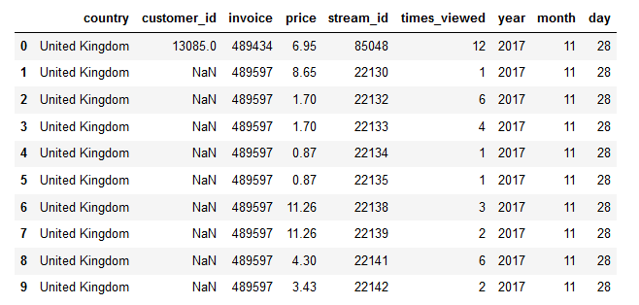
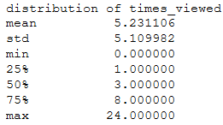
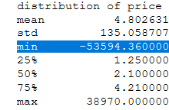
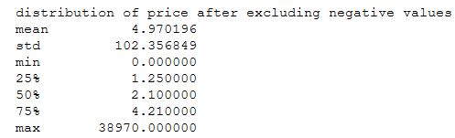
Data distribution
Total number of records: 7.335.099
Missing values:
All the attributes don’t have missing values, except the attribute customer_id (189.762 missing values, that is 2.59% of records)
First data preparation:
Remove strings in the values of the attribute stream_id
The attribute times_viewed is converted to numeric.
Distribution of times_viewed and price:
The attribute ‘price’ has negative values. The associated records are excluded before the monthly aggregation

Slide 7
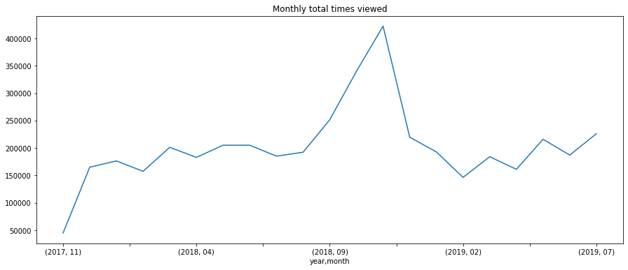
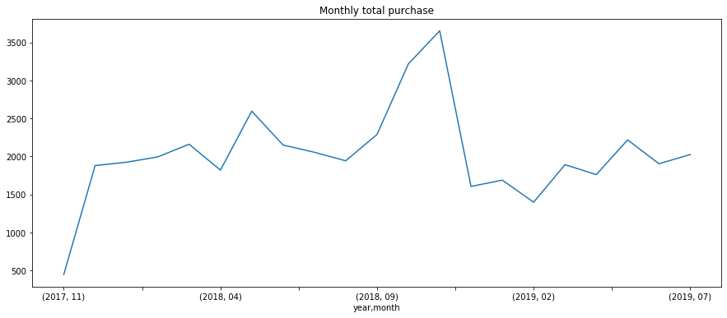
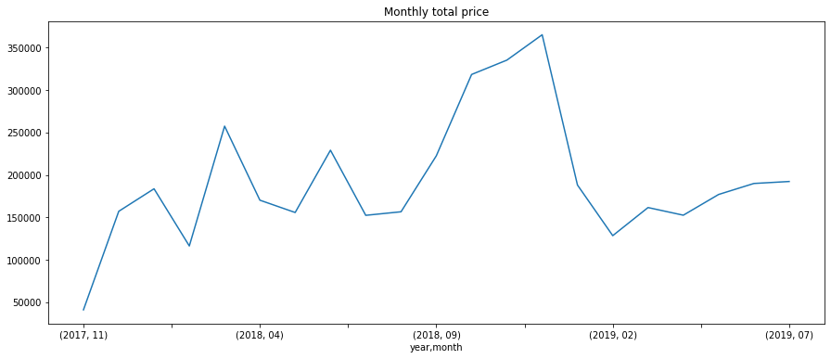
Monthly aggregation
As forecast is expected at monthly level, data are aggregated at monthly level
First observations are :
a « flat » trend
A strong spike in December 2018
Monthly aggregated data is in the file “invoices.csv”

Slide 8
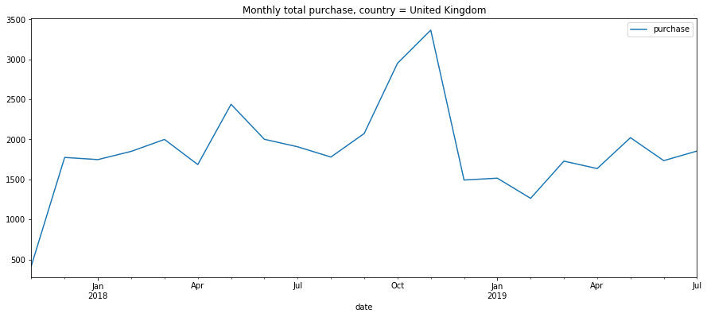
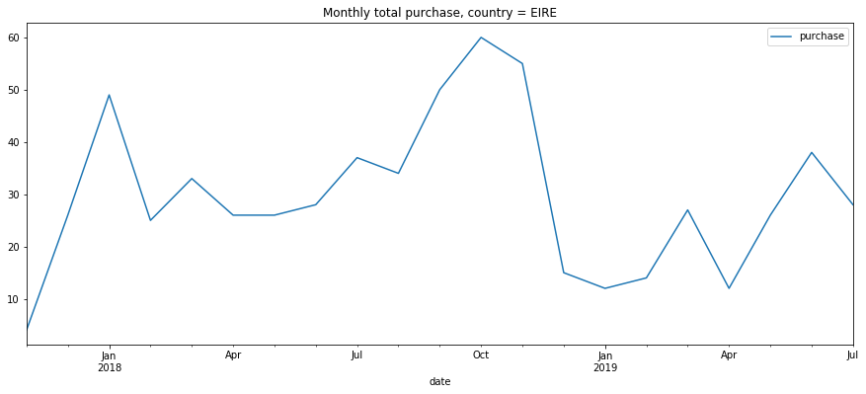
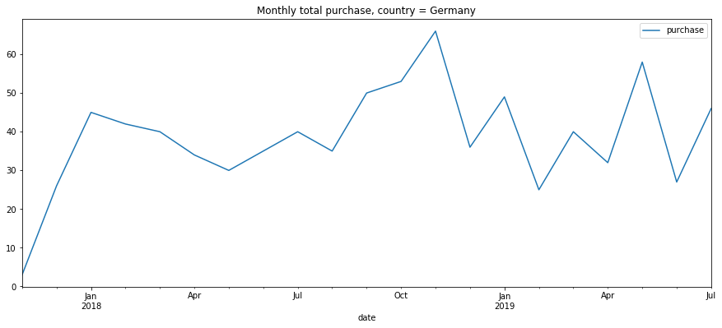
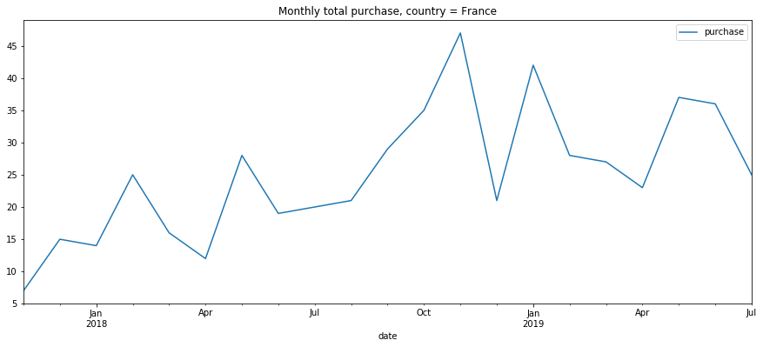
Monthly aggregation: top 9 countries (1)

Slide 9
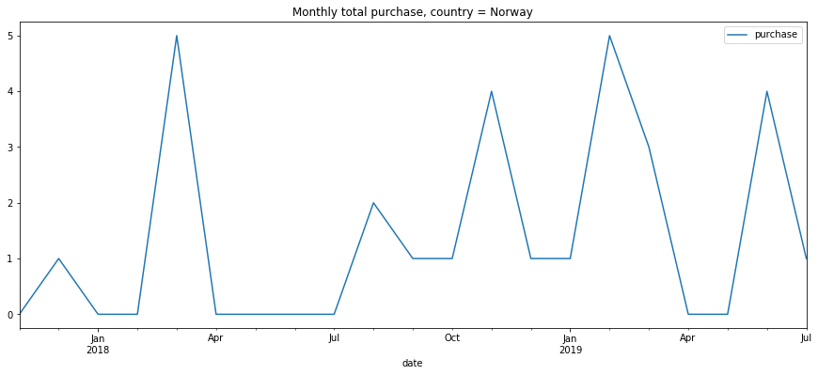
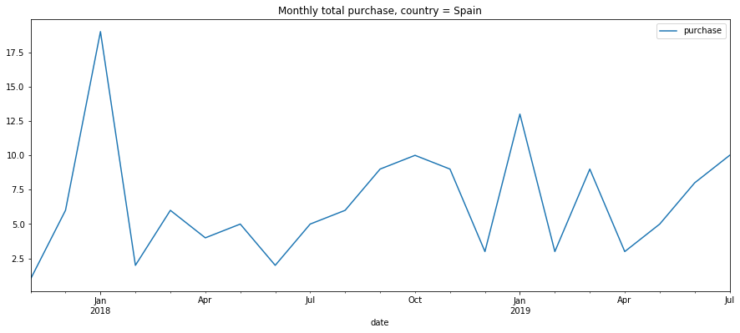
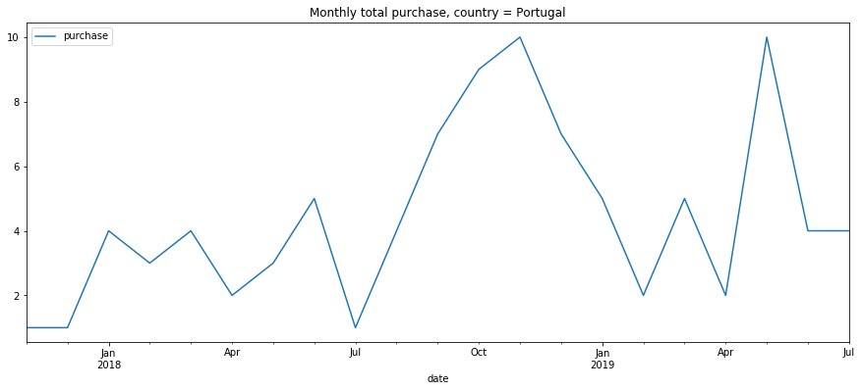
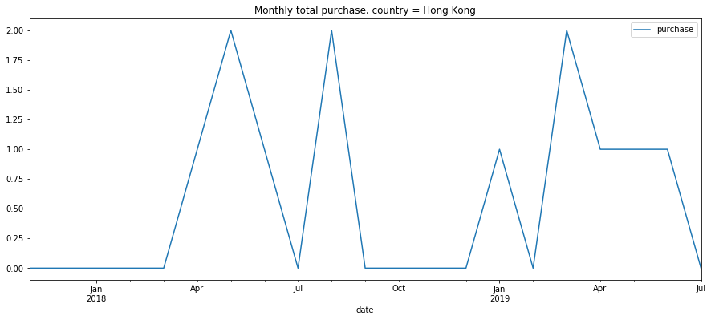
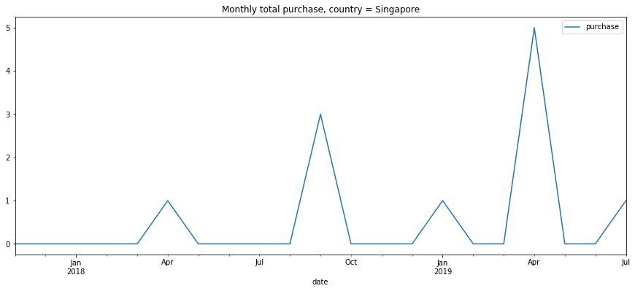
Monthly aggregation: top 9 countries (2)

Slide 10
Part 2
Notebook : Capstone - Part 1 and Part 2.ipynb

Slide 11
Modeling
The type of model considered is SARIMA Modeling
Detailed analysis is performed on monthly sum price « all countries », that is
ACF and PACF curves analysis
Test of Dicky Fuller
An Automatic search for the best ARIMA model is performed (performance criterion used is the AIC criterion)
For monthly sum price « all countries »
For monthly sum price « by country »

Slide 12
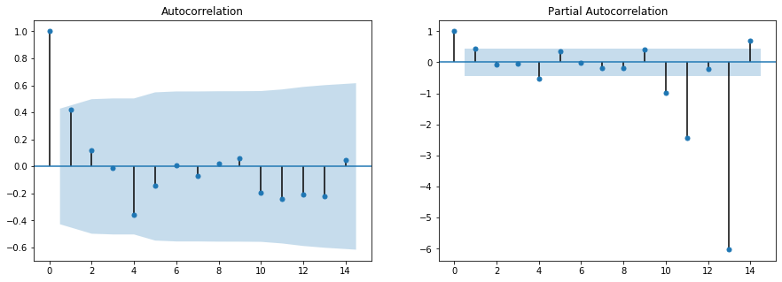
Detailed analysis on monthly sum price « all countries », ACF and PACF curves analysis
Observations:
The ACF shows a significant lag for 1 month.
The PACF shows a significant lag for 1 months
Both the ACF and PACF curves show a drop-off at the same point, perhaps suggesting a mix of AR and MA.
12 months Seasonality observed on the PACF curve
A good starting point for the ARMA part is p and q values set to 1

Slide 13
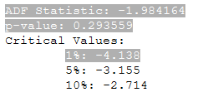
Detailed analysis on monthly sum price: Dickey-Fuller test
Observations:
The Dickey-Fuller test has not rejected the null hypothesis that a unit root is present.

Slide 14
Model selection
Several SARIMA models are built with a « grid search » performed on parameters (p,d,q) (p_seas,q_seas,d_seas,r_seas).
p = range(0, 2)
q = range(0, 2)
d = range(0,2)
p_seas = range(0, 2)
q_seas = range(0, 2)
d_seas = range(0,2)
r_seas = range(12,13)
The model selected is the one with the least AIC value

Slide 15
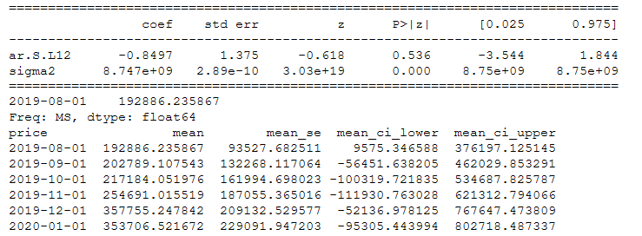
Model identification and computation
For the attribute - monthly sum price « all countries » - , the best model is the model SARIMA((0, 1, 0), (1, 1, 0, 12))
The AIC value is equal to 206
The picture below displays the coefficients estimates:

Slide 16
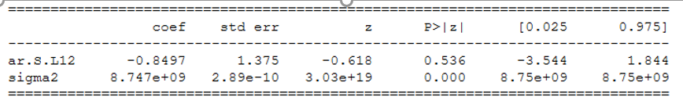
Model identification and computation
For the attribute - monthly sum price « all countries » - , the best model is the model SARIMA((0, 1, 0), (1, 1, 0, 12))
The AIC value is equal to 206
The picture below displays the coefficients estimates:

Slide 17
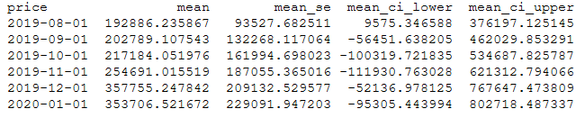
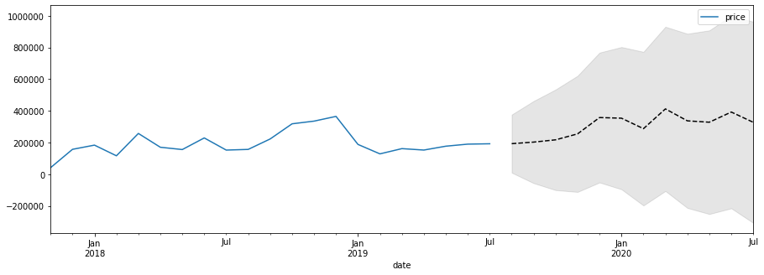
Forecasting (forecast next 6 months)
Example: forecast the next 6 months :

Slide 18
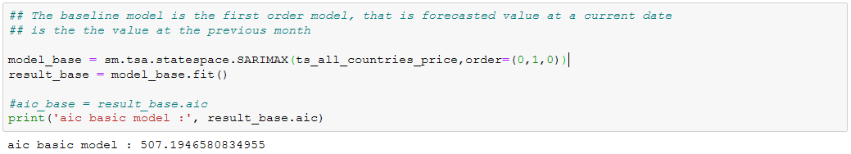
Comparison to a baseline model
The baseline model is the first order model (Y(t) = Y(t-1)) , that is the forecasted values are set to the last observed value
Forecasts are generated by the baseline model and by the targeted model for months 2019-08-01, 2019-09-01, 2019-10-01 and 2019-11-01 and RMSEs are compared:

Slide 19
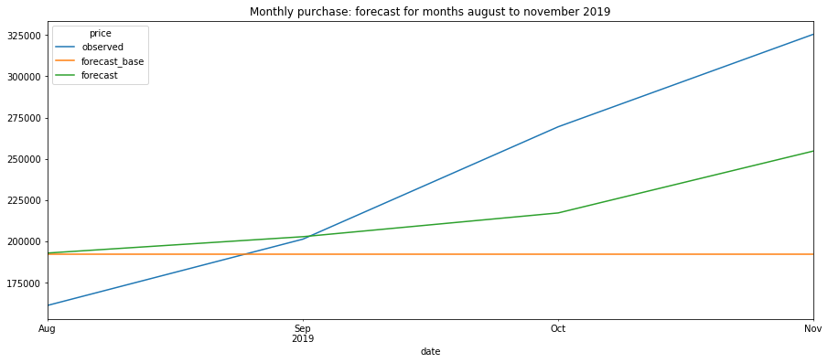
Comparison to a baseline model

Slide 20
Forecast by country
The modeling process performed on “all the countries” is performed by country. For each country,
Identification of the best SARIMA model (parameters (p,d,q) (p_seas,q_seas,d_seas,r_seas))
The “best” model is the model with the smallest AIC
This model is then used to perform forecasting

Slide 21
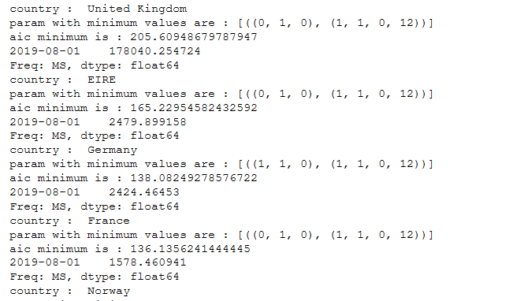
Forecast by country
Example:
Country = “United Kingdom”
AIC = 205,6
Parameters = [((0, 1, 0), (1, 1, 0, 12))]
Forecast for the month 2019-08-01: 178040

Slide 22
Part 3
Notebook : Capstone - Part 3.ipynb and capstone_unittest.ipynb
Python files : capstone_unittest.py capstone_logging.py

Slide 23
Flask APP and DockerFile: General description
To illustrate deployment, we focus only on the time series « all countries » and the attribute « Price ».
The notebook contains:
The function load_invoices_data() to load invoice data and prepare the dataframe
Train then store the SARIMA model ('capstone.joblib’)
Creation of the flask app.
Creation of the function get_forecast()
Create the Docker file
Start and test the Flask app

Slide 24
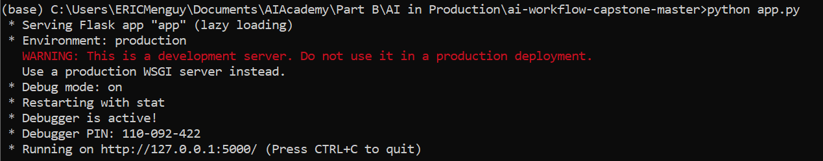
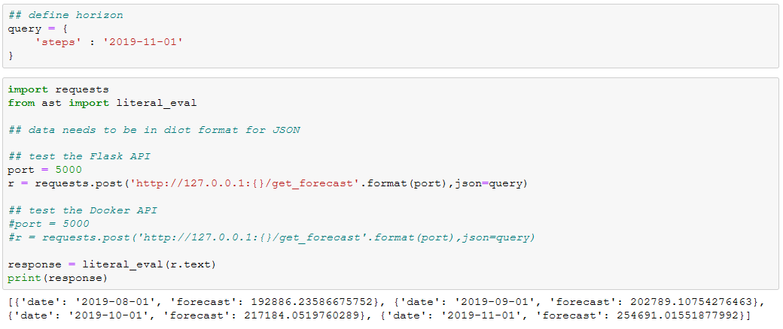
Start and test the Flask app

Slide 25
Unittest
To illustrate Unittest, a unitary test is defined to evaluate if the parameter input is in a dictionary and if the dictionary value has the date format yyy-mm-dd
File capstone_unittest.py

Slide 26
Logging
To illustrate Logging generation, a .py file is available for logging generation and update
File capstone-logging.py

